Slide 1
Presentation 7
MT3DMS—Solution Schemes
Notes:
SEAWAT Training Course
Lecture 7

Slide 2
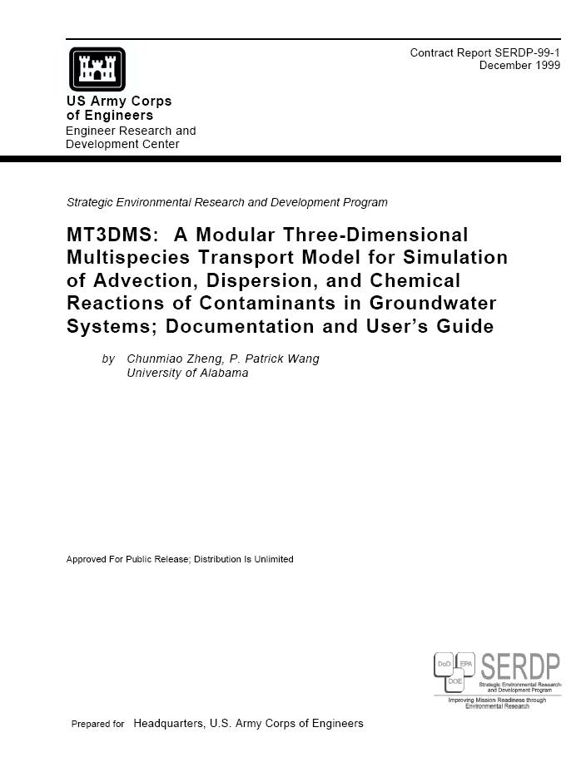
MT3DMS User Manual
http://hydro.geo.ua.edu/mt3d/mt3dmanual.pdf

Slide 3
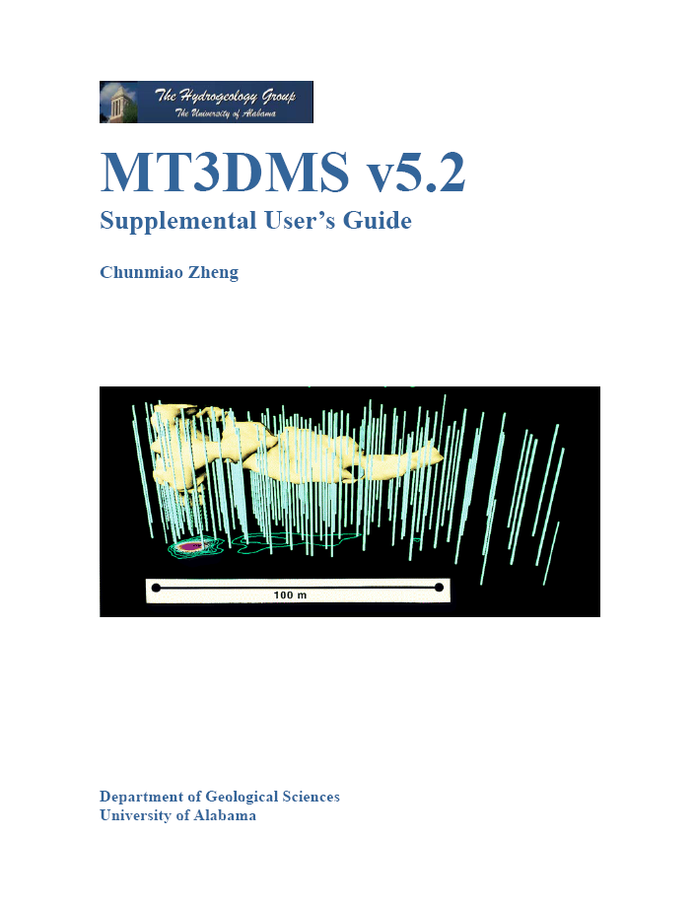
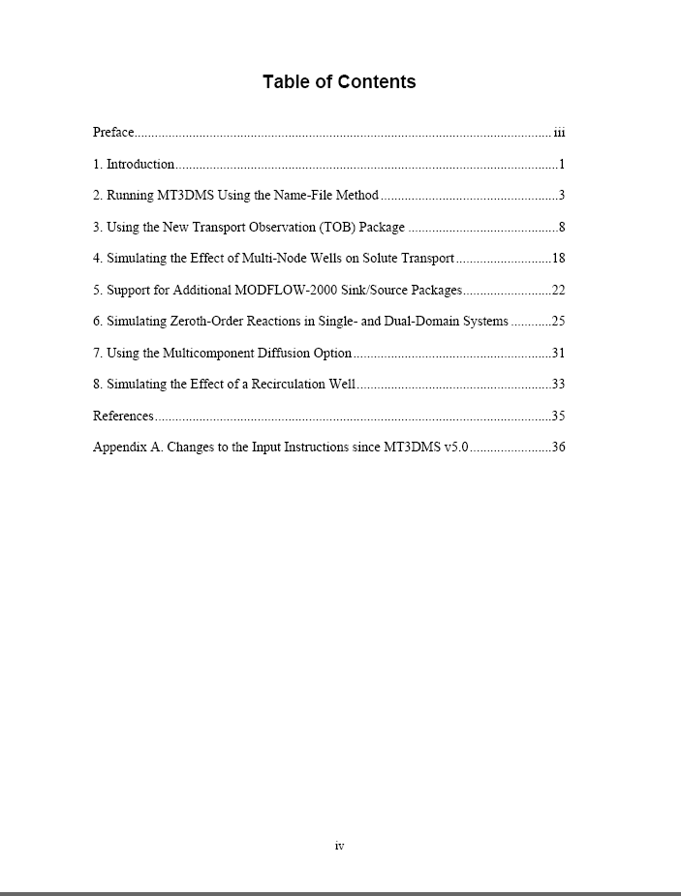
MT3DMS Supplemental Guide

Slide 4
History of MT3D
SSP&A
USEPA
UA/DoD
Ver.1.04
10/1990
Ver.1.04
10/1990
Ver.1.10
01/1992
Ver.1.10
01/1992
Ver.1.80
10/1992
Ver.1.85
06/1994
DoD_1.5
07/1996
MT3D’96
06/1996
MT3DMS 3.0
05/1998
MT3DMS 4.0
08/2001
MT3DMS 5.2
10/2006
MT3DMS 5.3
2/2010
Courtesy Chunmiao Zheng

Slide 5
Mathematical Model of Solute Transport
Governing equations
Initial conditions
Boundary conditions
Solutions:
  Analytical
  Numerical
Courtesy Chunmiao Zheng

Slide 6
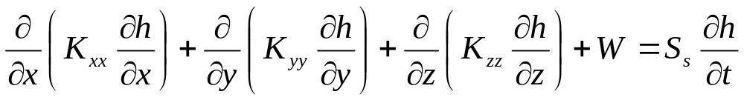
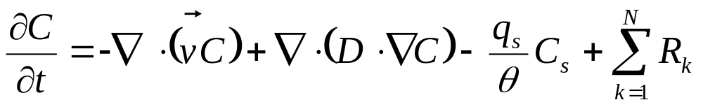
Governing Equations
Flow equations
  As solved in MODFLOW
  As solved in SEAWAT
Transport equation (as solved in MT3D)

Slide 7
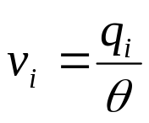
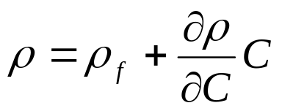
Governing Equations: Linkage Between Flow and Transport
Constant density
Variable density
concentrations are affected by flow
concentrations are affected by flow
flow is affected by concentrations

Slide 8
Initial Conditions
exisiting
landfill
10
5
1
C(x,y,z,0) determined from field data
(a) Initial condition characterized by an existing plume.
potential waste disposal site
C(x,y,z,0) = 0
(b) Initial condition characterized by zero concentration everywhere.
Courtesy Chunmiao Zheng

Slide 9
Boundary Conditions
Constant-concentration [Dirichlet]
Specified concentration gradient (i.e. dispersive flux) [Neumann]
  a special case is zero dispersive flux
Specified total mass flux (i.e., advective and dispersive) [Cauchy]
  a special case is zero mass flux
Courtesy Chunmiao Zheng

Slide 10
Boundary Conditions in MT3D
Specified-concentration boundary (try to avoid)
No flow boundary in MODFLOW is automatically treated as zero mass flux boundary
All other MODFLOW boundaries (including specified-flow, head-dependent flux, and constant head) are automatically treated as specified mass flux, with mass flux = QC, where Q is specified by user (WEL) or determined by MODFLOW (eg. GHB). Dispersive flux is always assumed to be negligible.

Slide 11
Solution of the Transport Equation
ADV
DSP
SSM
RCT
Fundamental difficulty: the need to treat simultaneously the first-order (hyperbolic) advection term and the second-order (parabolic) dispersion term
first order
second order
Courtesy Chunmiao Zheng

Slide 12
Solution Methods
Eulerian
  Fixed grid (standard finite difference or finite element)
Lagrangian
  Deforming grid or deforming coordinate in a fixed grid (particle based)
Mixed Eulerian-Lagrangian
  Combination of Eulerian and Langrangian methods

Slide 13
Example of Explicit Versus Implicit Methods
Explicit, forward difference formulation
Implicit, backward difference formulation
(e.g. MODFLOW)
h_{i,j,n+1}
h_{i,j+1,n}
h_{i,j+1,n}
h_{i-1,j,n}
h_{i+1,j,n}
h_{i-1,j,n}
h_{i+1,j,n}
h_{i,j-1,n}
h_{i,j-1,n}
h_{i,j,n-1}

Slide 14
Solution Approaches
Advection term
  Multiple approaches
Dispersion, Sink/Source, Chemical Reaction
  Explicit finite-difference method (original MT3D). Simple but subject to timestep constraints
  Implicit finite-difference method using GCG solver (MT3DMS). Requires a matrix solver, but no constraint on timestep size

Slide 15
Solution Schemes (advection term)
Standard finite difference
  Upstream weighting
  Central-in-space weighting
Method of characteristics
Modified method of characteristics
Hybrid method of characteristics
3rd-order total-variation diminishing (TVD) [ultimate]
Courtesy Chunmiao Zheng

Slide 16
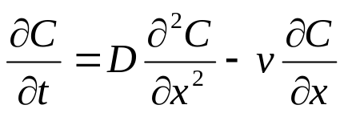
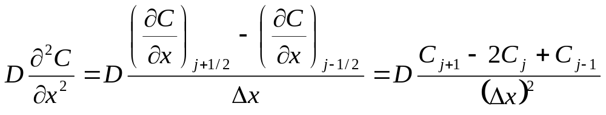
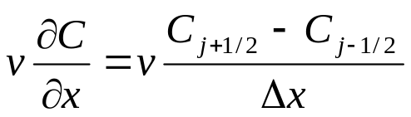
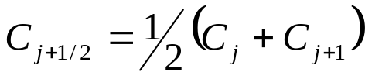


Finite-Difference Method
j-1/2
j+1/2
j-1
j
j+1
Δx
Central-in-space
Upstream (upwind)
or
Courtesy Chunmiao Zheng

Slide 17
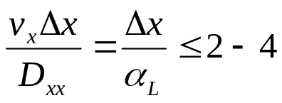
Advantages and Disadvantages of FDM
Advantages
  Mass conservative
  Computationally efficient for dispersion dominated problems
  No numerical difficulty for distorted model grids or in the presence of many sinks/sources
Disadvantages
  Suffer from numerical dispersion errors for advection-dominated problems or from artificial oscillation
  To minimize numerical dispersion errors, fine spatial discretization may be necessary, i.e., to satisfy the Peclet number constraint:
Courtesy Chunmiao Zheng

Slide 18
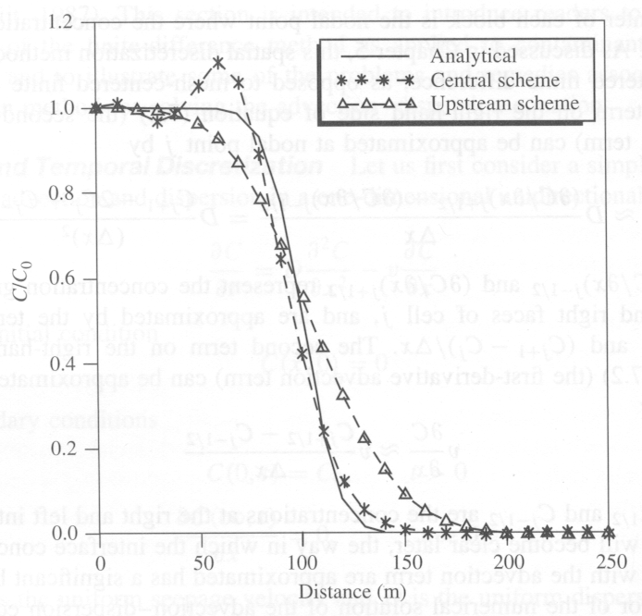
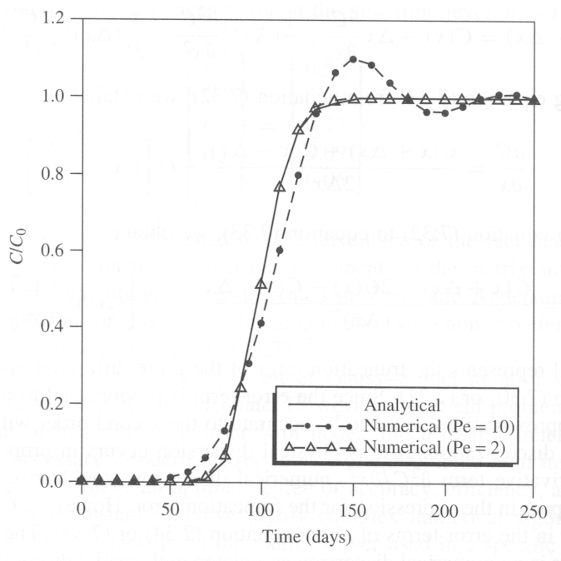
Numerical Problems Associated with FDM
Problems with central and upstream
Effect of advection domination (Peclet number)
Courtesy Chunmiao Zheng

Slide 19
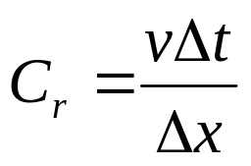
Courant Number
Number of cells, or fractional cell distance, that a particle is advected in one timestep

Slide 20
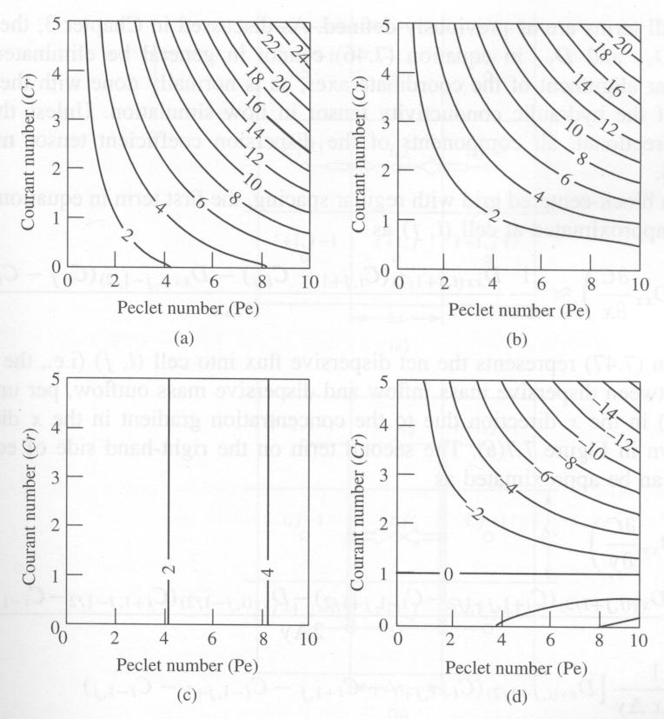
Ratio of Numerical to Physical Dispersion
Implicit, central-in-space
Implicit, upstream
Crank-Nicolson, upstream
Explicit, upstream
For simple, one-dimensional flow (Zheng and Bennett, 2002, p. 189)

Slide 21
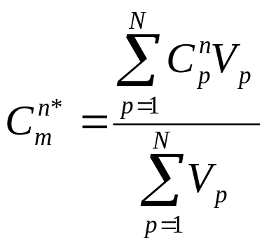
Method of Characteristics (MOC)
Each particle carries a volume and a concentration
Courtesy Chunmiao Zheng

Slide 22
Particle Allocation
Uniform Approach
  Particles distributed evenly throughout active model domain
Dynamic Approach
  Particles placed only in areas with high concentration gradients

Slide 23

Modified Method of Characteristics (MMOC)
Concentration at point P is interpolated from those at neighboring nodes
P
Courtesy Chunmiao Zheng

Slide 24
Hybrid Method of Characteristics (HMOC)
MOC is most effective when advection dominates over dispersion, while MMOC is only suitable when advection is less dominant
Apply MOC where advection dominates, dynamically adding particles as needed
Automatically switch to MMOC where advection is less dominant, removing particles that are no longer needed
Courtesy Chunmiao Zheng

Slide 25
Advantages and Limitation of Particle Methods
Advantages
  Virtually eliminate numerical dispersion
  Computationally efficient for highly advection-dominated problems
Disadvantages
  May have mass balance discrepancy problems, particularly when model grid is highly irregular
  Calculated concentration breakthrough curves may be “rough”
  Computer memory intensive, particularly for multi-species simulations, with a set of particles for each species
Courtesy Chunmiao Zheng

Slide 26
Third-Order TVD (ULTIMATE)
Also referred to as higher-order finite-difference or finite-volume method.
TVD—Total Variation Diminishing
  The sum of concentration differences between adjacent nodes diminishes over successive transport steps
ULTIMATE—Universal Limiter for Transient Interpolation Modeling of the Advective Transport Equations
Courtesy Chunmiao Zheng

Slide 27
TVD Concept
Use third-order polynomial (biased in the upstream direction) to interpolate concentration at –vΔt
Employ flux limiter to adjust interface concentrations if conditions indicate spurious oscillations could be a problem
Described in MT3DMS Manual (Zheng and Wang, 1998)

Slide 28
Advantages and Disadvantages of TVD
Advantages
  Mass conservative
  Minimal numerical dispersion and artificial oscillation for advection dominated problems
  No numerical difficulty for distorted model grids or in the presence of many sinks/sources
Disadvantages
  Could be computationally demanding
  May not be as effective as MOC in eliminating numerical dispersion for purely advective problems
Courtesy Chunmiao Zheng

Slide 29
Generalized Conjugate Gradient (GCG) Solver
General purpose iterative solver
Three preconditioning options
  Jacobi
  Symmetric Successive Over Relaxation
  Modified Incomplete Cholesky (MIC) (fewer iterations, more memory)
Lanczos/ORTHOMIN acceleration scheme
Two iteration loops (outer loop only required if matrix coefficients are a function of concentration: non-linear sorption)

Slide 30
List of Solution Options in MT3D
Group | Solution Options for Advection | Solution Options for Dispersion, Sinks/Source and Reaction
A | Particle Tracking Based Eulerian-Lagrangian Methods MOC MMOC HMOC | Explicit Finite Difference
B | Particle Tracking Based Eulerian-Lagrangian Methods MOC MMOC HMOC | Implicit Finite Difference
C | Explicit Finite Difference Upstream weighting | Explicit Finite Difference
D | Implicit Finite Difference Upstream weighting Central-in-space weighting | Implicit Finite Difference
E | Explicit Third-Order TVD | Explicit Finite Difference
F | Explicit Third-Order TVD | Implicit Finite Difference
Courtesy Chunmiao Zheng

